Slide 1

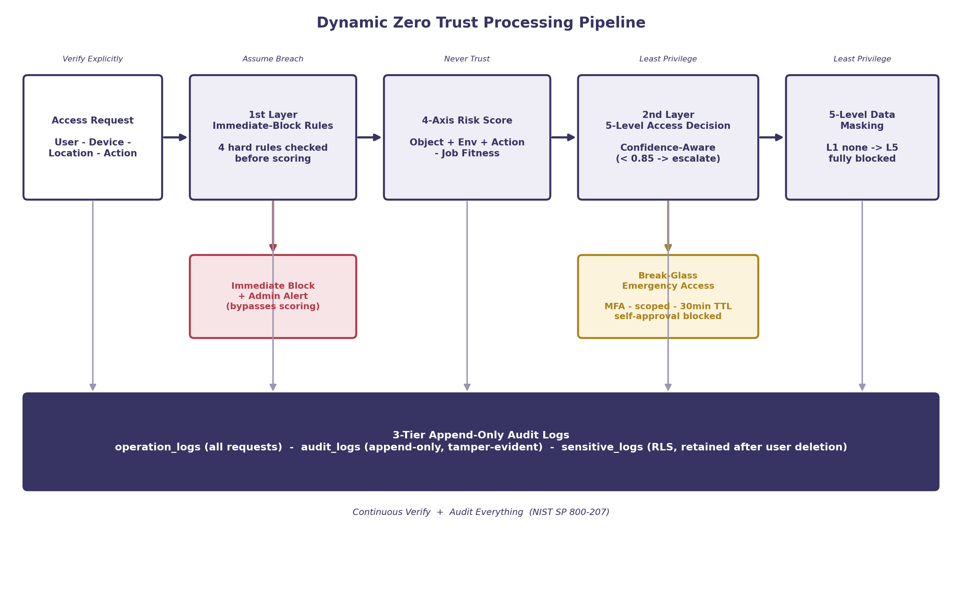
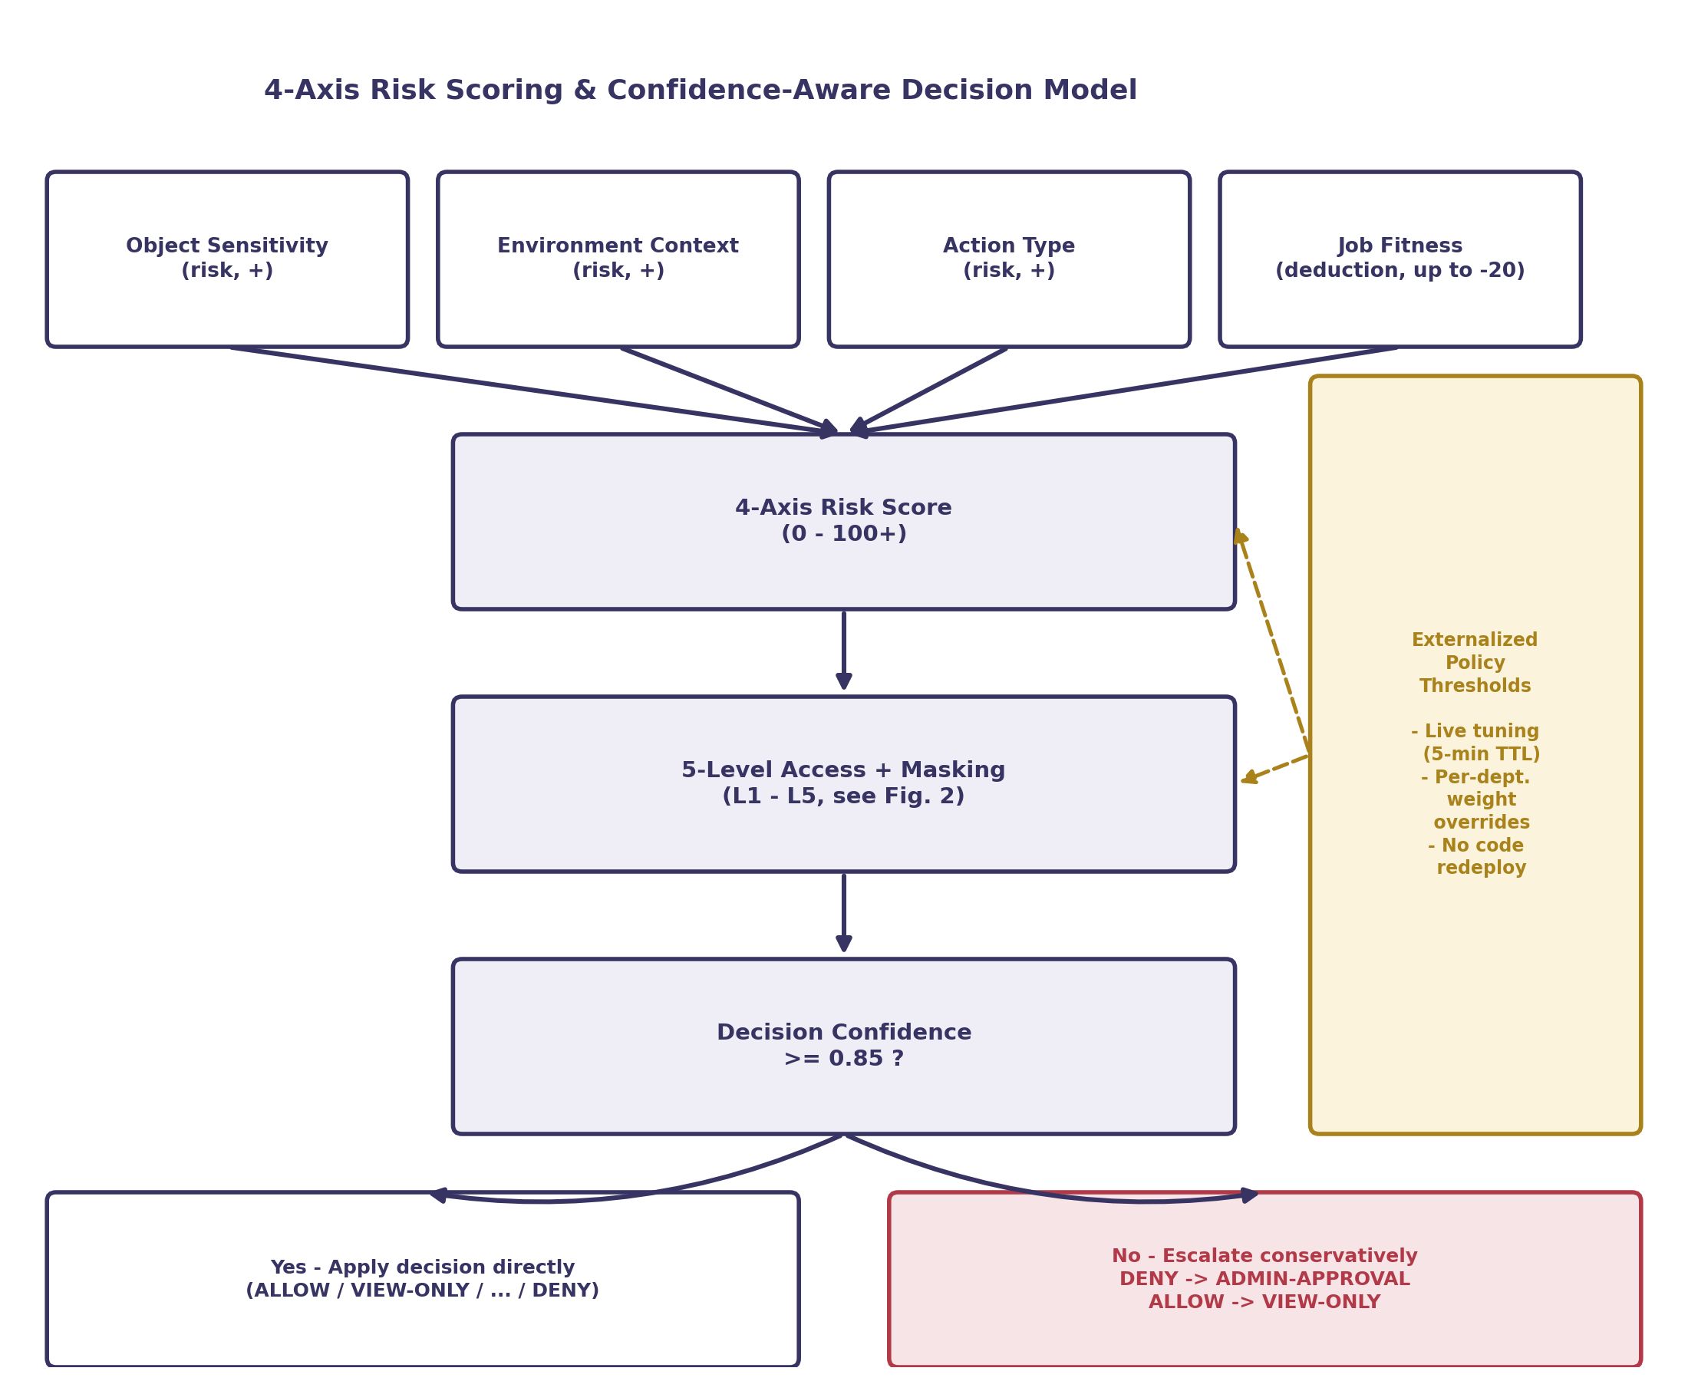
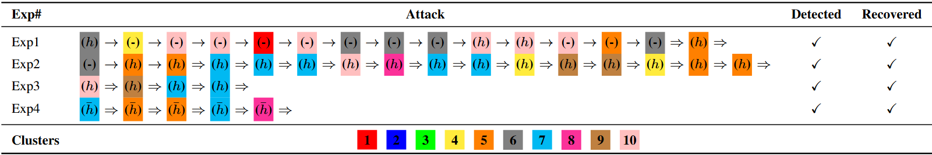
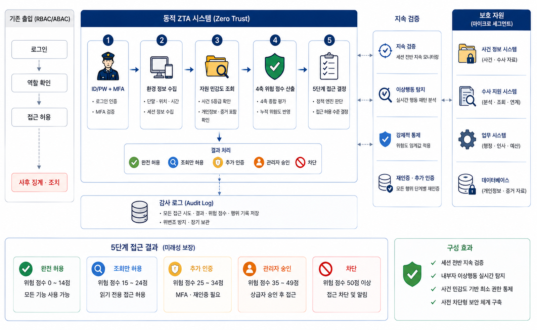
Dynamic Zero Trust Access Control System for Police
An Insider-Threat-Responsive Security System for Investigative Information
Team ZeroTrust | Jaehong Jeong / Jun Heo / Junwon Hong (Advisor: [Advisor Name])
[Department Name] / [University Name]
1. Problem
Recurring Police Insider Threats - Real prosecuted cases share one pattern: an authorized officer abuses legitimate access - leaking case details to a fugitive friend, performing an out-of-jurisdiction lookup as a favor and leaking the result, or repeatedly viewing unassigned case files even after a transfer. Two of the three resulted in prison sentences.
2. Existing Approach
Static RBAC/ABAC - Conventional systems grant a fixed role-based permission set at login and treat the whole session as trusted until logout, with no continuous re-check of device, location, or behavioral risk. An authorized-but-suspicious action proceeds unchecked, so insider abuse surfaces only through after-the-fact manual audit.
3. Proposed Structure
Dynamic Zero Trust Architecture - Login no longer implies permanent trust: every request is re-verified across 4 risk axes, mapped to 5 risk-based access levels with 5-level data masking, recorded in 3-tier append-only audit logs, with a controlled Break-Glass path for emergencies (Fig. 1).
4. Policy Model
4-Axis Risk Scoring - A quantitative model adds risk from object sensitivity, environment, and action type, then subtracts a job-fitness deduction, producing one risk score mapped to 5 access/masking levels (Fig. 2).
Confidence-Aware Thresholds - When decision confidence < 0.85, outcomes are escalated conservatively (DENY → ADMIN-APPROVAL, ALLOW → VIEW-ONLY); thresholds are externalized for live tuning (5-min TTL) and per-department weight overrides without code redeployment (Fig. 3).
5. Features
NIST SP 800-207 Mapping & Dual Safety Net - The six Zero Trust principles (Never Trust, Continuous Verify, Least Privilege, Assume Breach, Verify Explicitly, Audit Everything) are each mapped to a concrete feature (Fig. 1). Before scoring, 4 hard rules - concurrent-device auth failure, high-risk download, impossible travel, disallowed location - trigger an immediate block and audit log, independent of the risk score.
Break-Glass & 3-Tier Audit - Emergency access is MFA-gated, scoped to one resource or all level-4+ resources, time-limited (30-min TTL, 5-min idle auto-expiry), and dual-control (no self-approval); every action is recorded across 3 append-only audit layers - operation, audit, and sensitive logs.
6. Differentiators
Three Novel Contributions - ① Confidence-Aware Decisions converge uncertain judgments to extra verification instead of a binary allow/deny. ② 4-Axis Separated Scoring keeps risk additions and the job-fitness deduction independently auditable. ③ Externalized Policy Thresholds allow live tuning and per-department overrides without redeployment (Fig. 3).
7. Implementation
Stack & 5-Level Outcomes - Built on Tornado + PostgreSQL (21 migrations), pyotp-based TOTP MFA, and JWT with iss/aud claims. The 4-axis risk score maps to 5 separated levels of action permission and data masking (Fig. 2).
3 Demo Scenarios - ① an unassigned-case lookup is masked/watermarked and downloads are blocked from low confidence; ② a login from an unregistered jurisdiction is blocked at the location-verification step before authentication completes; ③ repeated unassigned-case access accumulates action risk until the access level and permissions are downgraded in real time. All attempts are fully audited.
8. Pros & Cons
Strengths vs. Limitations - Real-time, explainable, live-tunable, and fully audited end-to-end, versus a single-PostgreSQL deployment with rule-based scoring validated through 3 demos rather than production-scale trials. ML-assisted weighting and multi-agency rollout are future work.
9. Expected Effects
From Detection to Prevention - Proactive behavior-based prevention, 5-level masking, continuous re-verification, and full 3-tier auditability (see summary below).
Fig. 1. Dynamic Zero Trust Processing Pipeline - Immediate-Block Rules (1st layer) → 4-Axis Risk Score → Confidence-Aware 5-Level Decision (2nd layer) → 5-Level Masking, with Break-Glass as a controlled emergency path and every step recorded in the 3-tier audit trail
Fig. 3. 4-Axis Risk Scoring and Confidence-Aware Decision Model - risk additions (object sensitivity, environment, action) minus a job-fitness deduction produce one score mapped to 5 access/masking levels; low-confidence decisions are escalated via externalized, live-tunable policy thresholds.
Access Level | Risk Score Range | Action Permission | Masking Level
L1 | 0 - 25 | Full Access - View / Download / Copy / Print | No Masking
L2 | 26 - 50 | View Only - Download / Copy / Print blocked | Watermark Applied
L3 | 51 - 75 | Re-authentication Required - view allowed after re-auth | Partial Masking
L4 | 76 - 90 | Admin Approval Required - download only upon approval | Summary Only
L5 | 91 + | Immediate Block - all actions blocked | Fully Blocked
Fig. 2. 5-Level Access Outcomes and Masking Levels by Risk Score Range - Confidence-Aware Decisions: when confidence < 0.85, DENY is escalated to ADMIN-APPROVAL and ALLOW to VIEW-ONLY (decision-engine.py + masking-engine.py)
Results Summary
Strengths & Limitations - Real-time, behavior-based prevention with an auditable, explainable 4-axis risk model, live-tunable policy thresholds, and a tamper-evident 3-tier audit trail; current validation is via 3 scenario-based demos on a single PostgreSQL deployment, with ML-assisted risk weighting and multi-agency deployment as future work.
Proactive Prevention | Minimal Exposure | Continuous Verification | Full Auditability
Detects and blocks insider abuse in real time at the action stage (after-the-fact detection -> proactive prevention) | Minimizes information exposure via 5-level risk-based access + 5-level data masking | Dynamically re-evaluates and re-authenticates the session continuously, even after login | 3-tier append-only logs track all access and guarantee integrity

